Slide 1



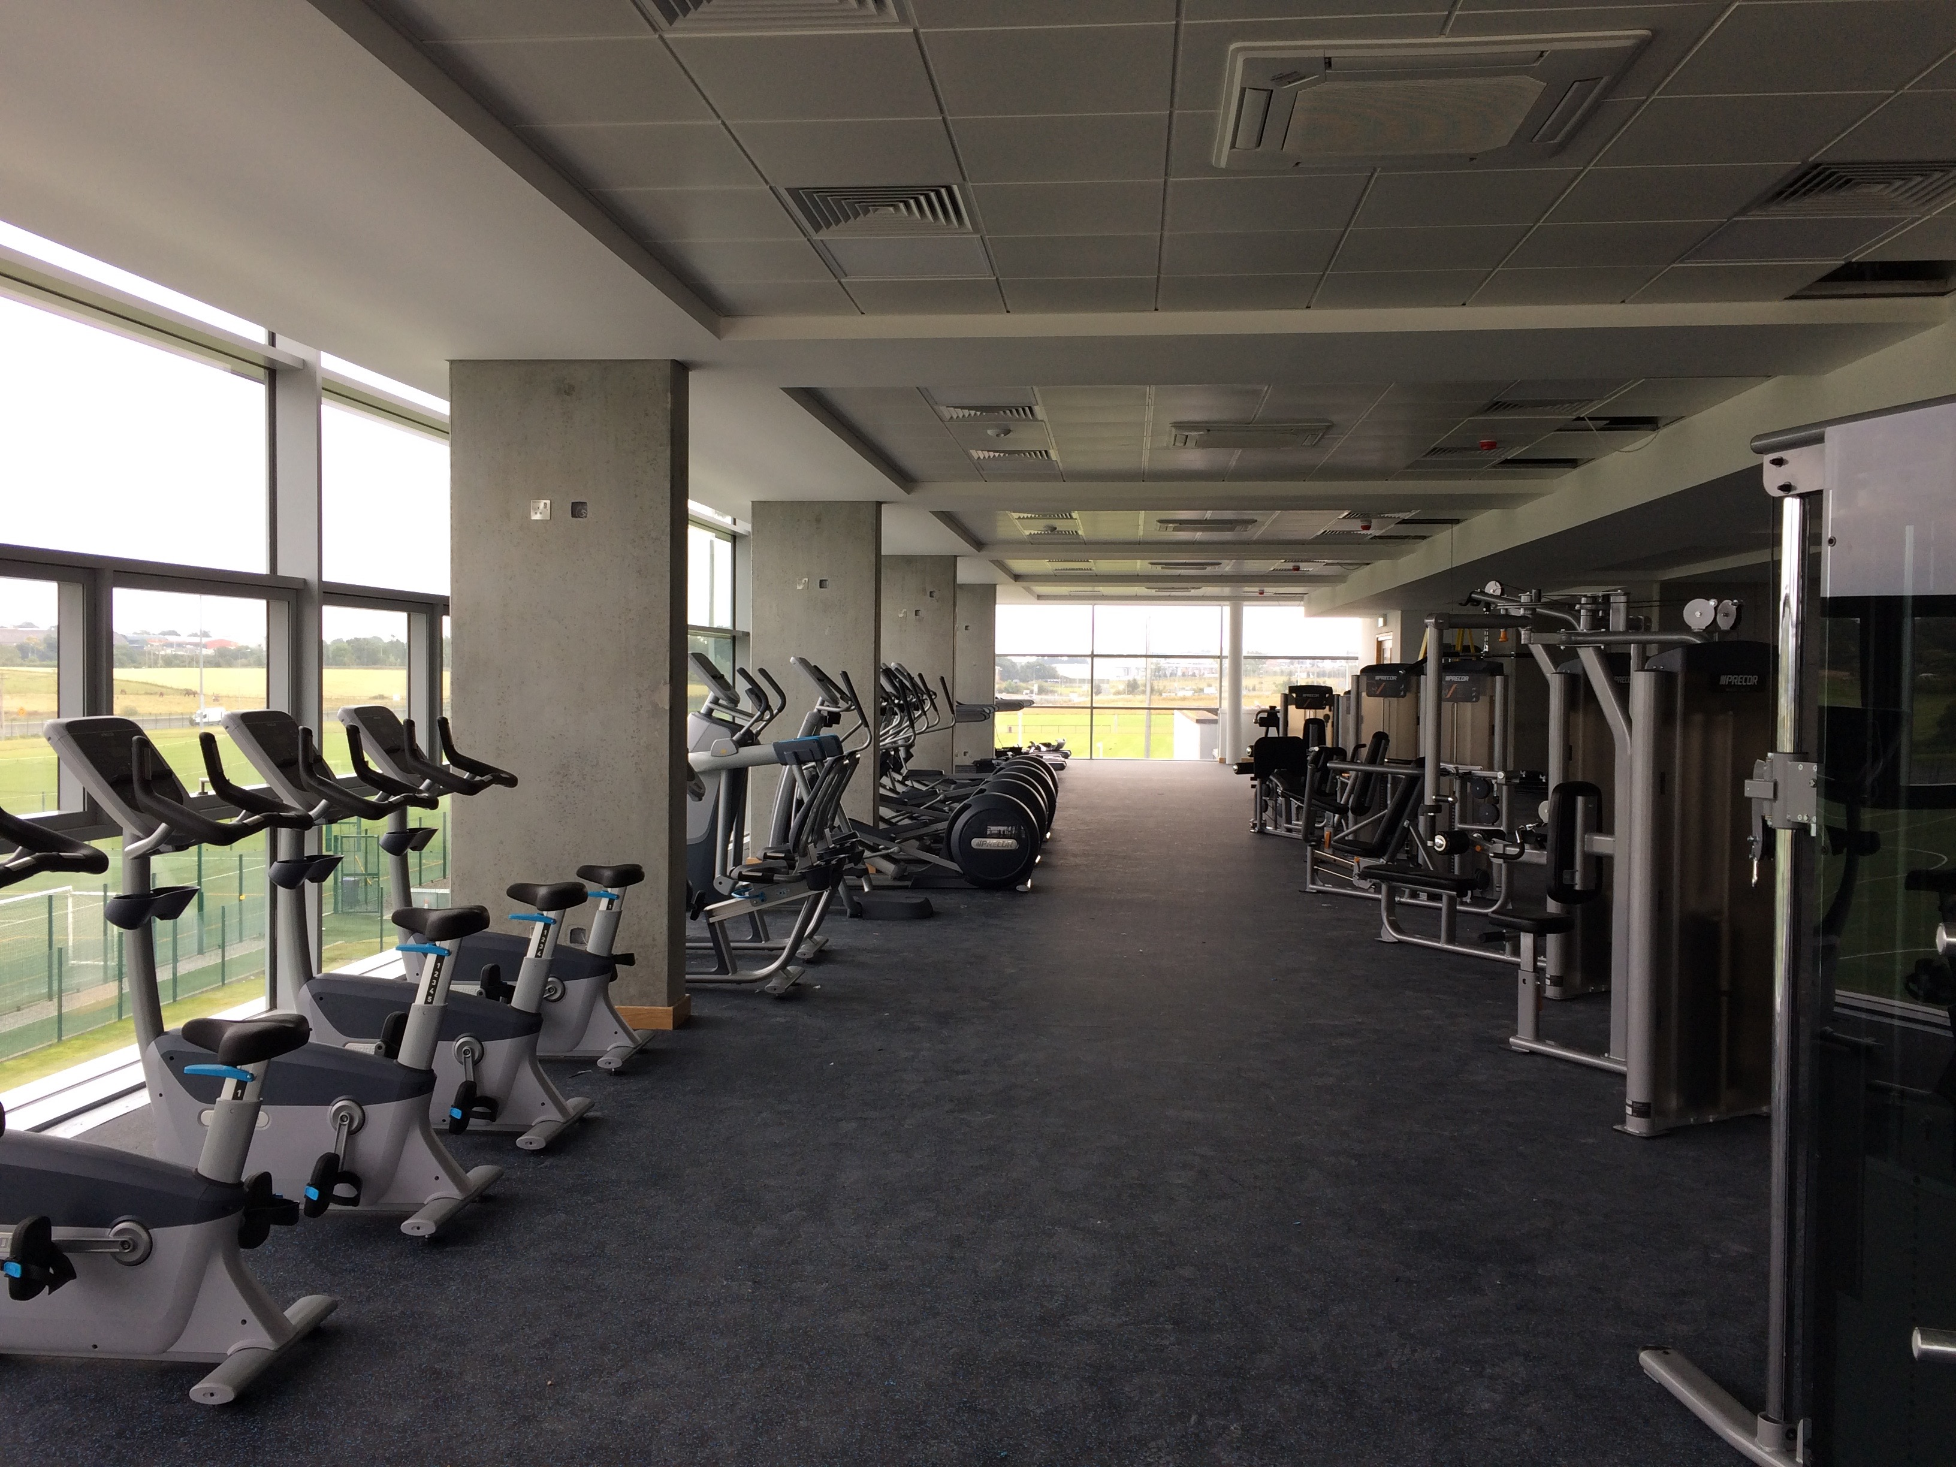
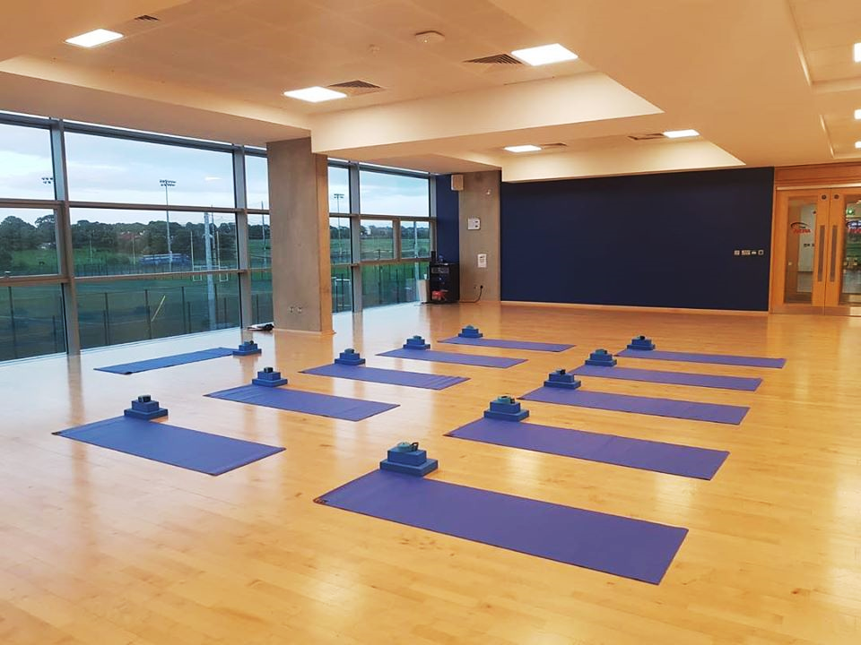
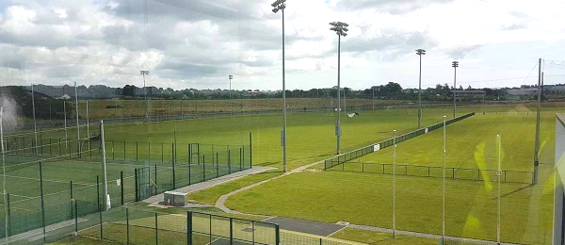
QUICK ACCESS
Pin topics here to access them quicker!
GYM MEMBERSHIP
FITNESS CLASSES
MEET OUR TRAINERS
Notes:
Only ‘Gym membership’ can be pinned here for Prototype purposes

Slide 2
QUICK ACCESS
GYM MEMBERSHIP
FITNESS CLASSES
MEET OUR TRAINERS
Notes:
I couldn’t incorporate a scrollbar here, so the next slide is simply the lower half of the main page – press enter to mimic scrolling down

Slide 3
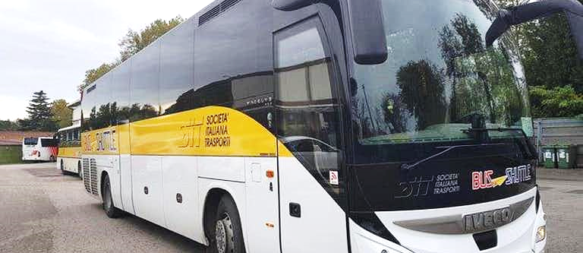
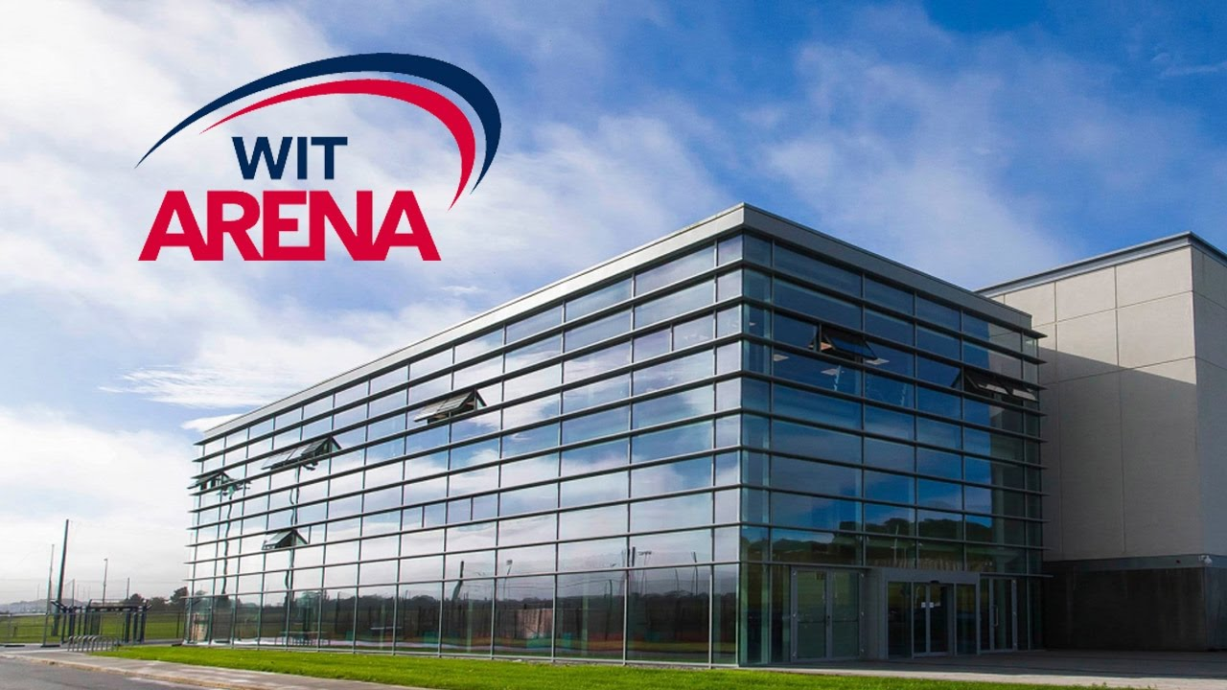
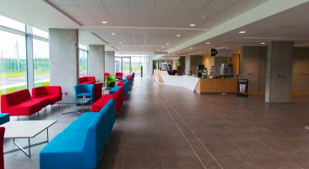
RENT OUT OUR FACILITIES
SHUTTLEBUS TIMETABLE
FULL INDOOR AND OUTDOOR MAP OF THE ARENA
OUR CAFÉ MENU

Slide 4
QUICK ACCESS
Pin topics here to access them quicker!
GYM MEMBERSHIP
FITNESS CLASSES
MEET OUR TRAINERS
Notes:
I couldn’t incorporate a scrollbar here, so the next slide is simply the lower half of the main page – press enter to mimic scrolling down

Slide 5
RENT OUT OUR FACILITIES
SHUTTLEBUS TIMETABLE
FULL INDOOR AND OUTDOOR MAP OF THE ARENA
OUR CAFÉ MENU

Slide 6
Register for an account today to manage bookings, save payment details, and more!
QUICK ACCESS
Pin topics here to access them quicker!
CREATE MY ACCOUNT
LOG IN HERE
Already have an account?
FAQ
GYM MEMBERSHIP
TERMS OF SERVICE
CONTACT US
FITNESS CLASSES
MEET OUR TRAINERS
Notes:
This menu is for users not logged in to the app.

Slide 7


QUICK ACCESS
Pin topics here to access them quicker!
Username
Member / Non member of WIT Arena
MANAGE MY BOOKINGS AND MEMBERSHIP
GYM MEMBERSHIP
ACCOUNT SETTINGS
FAQ
FITNESS CLASSES
TERMS OF SERVICE
CONTACT US
MEET OUR TRAINERS
Notes:
This menu is for users logged into the app.

Slide 8

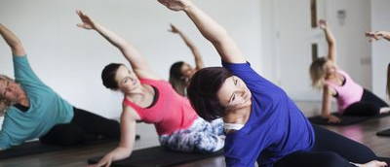
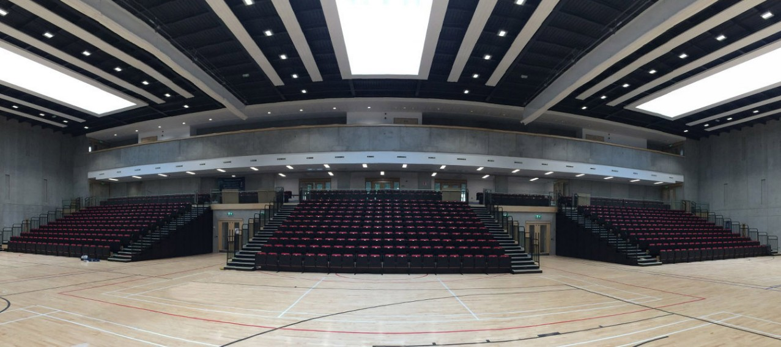
My Membership Plan
Manage
My Classes
PILATES
Mon 8am-8.45am
Manage
My Hires
DEPOSIT DUE
This deposit is due in 10 days
AUDITORIUM
May 21st
Manage

Slide 9
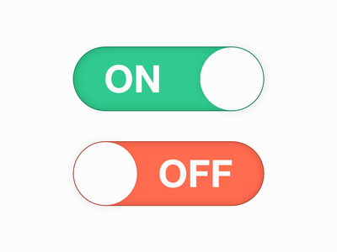



Account Settings
Name:
What would you like to do?
Membership status:
Username
Student member
edit
edit
Cancel my Membership
Notifications
Class Reminder
Change of Class
Bus Reminder
Change of Bus
Payments due
Be reminded when one of your classes is coming up
Renew my Membership under a different card
Be notified when one of your classes has been cancelled / change time
Be reminded when your bus is set to arrive
Be notified when there is a change in the shuttlebus timetable
Be reminded when one of your fees is due soon
One week in advance
edit
Link Account with Facebook
Link Account with Twitter
Log Out

Slide 10
Account Settings
Name:
Your membership has been cancelled.
Membership status:
Username
Student member
edit
edit
Notifications
RETURN HOME
Class Reminder
Change of Class
Bus Reminder
Change of Bus
Payments due
Be reminded when one of your classes is coming up
Be notified when one of your classes has been cancelled / change time
Be reminded when your bus is set to arrive
Be notified when there is a change in the shuttlebus timetable
Be reminded when one of your fees is due soon
One week in advance
edit
Link Account with Facebook
Link Account with Twitter
Log Out

Slide 11
Account Settings
Please enter your new Debit/Credit Card details below:
Name:
Membership status:
Username
Student member
edit
edit
Card Number*
Notifications
RETURN HOME
Class Reminder
Change of Class
Bus Reminder
Change of Bus
Payments due
Expiry Date*
Security Code*
Be reminded when one of your classes is coming up
MM/YYYY
Be notified when one of your classes has been cancelled / change time
Be reminded when your bus is set to arrive
Be notified when there is a change in the shuttlebus timetable
Be reminded when one of your fees is due soon
One week in advance
CONFIRM
CANCEL
edit
Link Account with Facebook
Link Account with Twitter
Log Out

Slide 12
Account Settings
Name:
Your membership will be renewed under your new card.
Membership status:
Username
Student member
edit
edit
Notifications
RETURN HOME
Class Reminder
Change of Class
Bus Reminder
Change of Bus
Payments due
Be reminded when one of your classes is coming up
Be notified when one of your classes has been cancelled / change time
Be reminded when your bus is set to arrive
Be notified when there is a change in the shuttlebus timetable
Be reminded when one of your fees is due soon
One week in advance
edit
Link Account with Facebook
Link Account with Twitter
Log Out

Slide 13
Account Settings
Name:
What would you like to do?
Membership status:
Username
Student member
edit
edit
Cancel this Class
Notifications
Class Reminder
Change of Class
Bus Reminder
Change of Bus
Payments due
Be reminded when one of your classes is coming up
Be notified when one of your classes has been cancelled / change time
Be reminded when your bus is set to arrive
Be notified when there is a change in the shuttlebus timetable
Be reminded when one of your fees is due soon
One week in advance
edit
Link Account with Facebook
Link Account with Twitter
Log Out

Slide 14
Account Settings
Name:
Your class has been cancelled.
Membership status:
Username
Student member
edit
edit
Notifications
RETURN HOME
Class Reminder
Change of Class
Bus Reminder
Change of Bus
Payments due
Be reminded when one of your classes is coming up
Be notified when one of your classes has been cancelled / change time
Be reminded when your bus is set to arrive
Be notified when there is a change in the shuttlebus timetable
Be reminded when one of your fees is due soon
One week in advance
edit
Link Account with Facebook
Link Account with Twitter
Log Out

Slide 15
Account Settings
Name:
What would you like to do?
Membership status:
Username
Student member
edit
edit
Cancel this hire
Notifications
Class Reminder
Change of Class
Bus Reminder
Change of Bus
Payments due
Be reminded when one of your classes is coming up
Pay Deposit due of €50
Be notified when one of your classes has been cancelled / change time
This deposit is due in 10 days
Be reminded when your bus is set to arrive
Be notified when there is a change in the shuttlebus timetable
Be reminded when one of your fees is due soon
One week in advance
edit
Link Account with Facebook
Link Account with Twitter
Log Out

Slide 16
Account Settings
Name:
Your hire has been cancelled.
Membership status:
Username
Student member
edit
edit
Notifications
RETURN HOME
Class Reminder
Change of Class
Bus Reminder
Change of Bus
Payments due
Be reminded when one of your classes is coming up
Be notified when one of your classes has been cancelled / change time
Be reminded when your bus is set to arrive
Be notified when there is a change in the shuttlebus timetable
Be reminded when one of your fees is due soon
One week in advance
edit
Link Account with Facebook
Link Account with Twitter
Log Out

Slide 17
Account Settings
Please enter the details of the Debit/Credit Card you are using to pay below:
Name:
Membership status:
Username
Student member
edit
edit
Card Number*
Notifications
RETURN HOME
Class Reminder
Change of Class
Bus Reminder
Change of Bus
Payments due
Expiry Date*
Security Code*
Be reminded when one of your classes is coming up
MM/YYYY
Be notified when one of your classes has been cancelled / change time
Be reminded when your bus is set to arrive
Be notified when there is a change in the shuttlebus timetable
Be reminded when one of your fees is due soon
One week in advance
CONFIRM
CANCEL
edit
Link Account with Facebook
Link Account with Twitter
Log Out

Slide 18
Account Settings
Name:
Thank you. Your deposit is being processed.
Membership status:
Username
Student member
edit
edit
Notifications
RETURN HOME
Class Reminder
Change of Class
Bus Reminder
Change of Bus
Payments due
Be reminded when one of your classes is coming up
Be notified when one of your classes has been cancelled / change time
Be reminded when your bus is set to arrive
Be notified when there is a change in the shuttlebus timetable
Be reminded when one of your fees is due soon
One week in advance
edit
Link Account with Facebook
Link Account with Twitter
Log Out

Slide 19
Account Settings
Name:
Membership status:
Username
Monthly member
edit
edit
Notifications
Class Reminder
Change of Class
Bus Reminder
Change of Bus
Payments due
Be reminded when one of your classes is coming up
Be notified when one of your classes has been cancelled / change time
Be reminded when your bus is set to arrive
Be notified when there is a change in the shuttlebus timetable
Be reminded when one of your fees is due soon
One week in advance
edit
Link Account with Facebook
Link Account with Twitter
Log Out
Notes:
Only ‘class reminder’ works for demonstration purposes

Slide 20
Account Settings
Name:
Which class(es) would you like to set reminders for?
Membership status:
Username
Student member
edit
edit
Notifications
Class Reminder
Change of Class
Bus Reminder
Change of Bus
Payments due
Be reminded when one of your classes is coming up
PILATES
Mon 8am-8.45am
Be notified when one of your classes has been cancelled / change time
Be reminded when your bus is set to arrive
Be notified when there is a change in the shuttlebus timetable
Be reminded when one of your fees is due soon
One week in advance
edit
Link Account with Facebook
Link Account with Twitter
Log Out

Slide 21
Account Settings
Name:
When would you like to be reminded?
Membership status:
Username
Student member
edit
edit
12 hours before
24 hours before
Notifications
Class Reminder
Change of Class
Bus Reminder
Change of Bus
Payments due
Other:
Be reminded when one of your classes is coming up
Be notified when one of your classes has been cancelled / change time
Be reminded when your bus is set to arrive
Be notified when there is a change in the shuttlebus timetable
Be reminded when one of your fees is due soon
One week in advance
edit
Link Account with Facebook
Link Account with Twitter
Log Out
Notes:
More inclusive options would be in the final version.

Slide 22
Account Settings
Name:
Membership status:
Username
Student member
edit
edit
Notifications
Class Reminder
Change of Class
Bus Reminder
Change of Bus
Payments due
Be reminded when one of your classes is coming up
12/24 hours in advance
Be notified when one of your classes has been cancelled / change time
edit
Be reminded when your bus is set to arrive
Be notified when there is a change in the shuttlebus timetable
Be reminded when one of your fees is due soon
One week in advance
edit
Link Account with Facebook
Link Account with Twitter
Log Out
Notes:
Only ‘class reminder’ works for demonstration purposes

Slide 23
YOU’VE BEEN LOGGED OUT SUCCESSFULLY
RETURN HOME

Slide 24
Frequently Asked Questions
Q: What’s the difference between an account and membership?
A: Creating an account allows you to manage how you interact with the Arena, whether you are a member or not. For example, an account allows non-members to book classes and hire out facilities quickly and easily. Membership grants our customers with Arena privileges and access to more facilities. A full list of our memberships and what they entail can be found on our App here.
Q: What does membership at WIT Arena give me?
A: A full list of our memberships and what they entail can be found on our App here.
Q: How do I cancel a class I booked?
A: You can cancel and alter your bookings quickly and easily here.
Q: How long after I place a request to hire should I expect a phone call back?
A: You can expect a phone call back within 5 working days. However, if you don’t hear back from us within 5 working days, please contact us and let us know. There may have been a problem processing your request.
Q: Can I be notified when my bookings are coming up?
A: Of course! You can set your notifications here to be reminded of class and bus times relevant to you.

Slide 25
Contact Us
Address: WIT Arena West Campus Carriganore Co. Waterford Ireland Email Address: witarena@wit.ie Phone Number: +353 (0)51 834444

Slide 26
REGISTER FOR AN ACCOUNT
This registration gives you your own account with our App to better manage and store your bookings with us.
To register for membership with us,
Click here
Register with Facebook
Register with Twitter
OR fill in your details below
Full name*
Email Address*
Create a Password*
Confirm Password*
County
Are you a student at Waterford Institute of Technology?
Yes
No
REGISTER
CLEAR FORM

Slide 27
REGISTRATION COMPLETE
An Email confirmation has been sent to your inbox. Please follow the instructions to confirm your Email address.
RETURN HOME
ABOUT GYM MEMBERSHIP

Slide 28
LOG IN
Log in with Facebook
Log in with Twitter
OR
Email Address
Password
LOG IN

Slide 29
LOG IN SUCCESSFUL
RETURN HOME

Slide 30



At WIT Arena, we have a variety of membership plans. Take a look at our options below to help you choose what’s best for you.
If you have any queries or need help making your decision, feel free to contact us here.
Details
Details
Details
To renew or manage current membership plans directly from our app, create an account with us here.
Notes:
I couldn’t incorporate a scrollbar, but it can be presumed the Private Membership details and the text boxes above and below the options could be viewed successfully with scrolling.

Slide 31
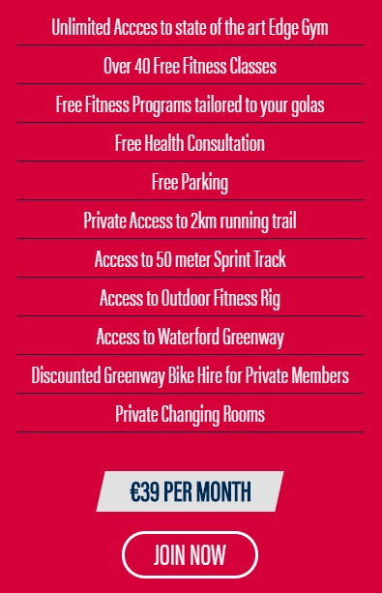
Details
START NOW

Slide 32
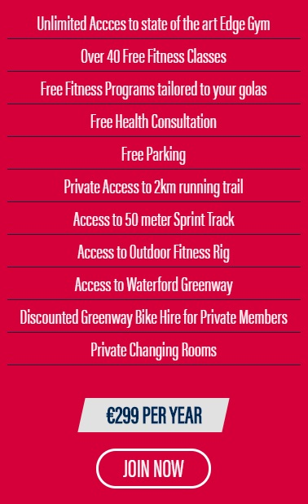
Details
Details
START NOW

Slide 33
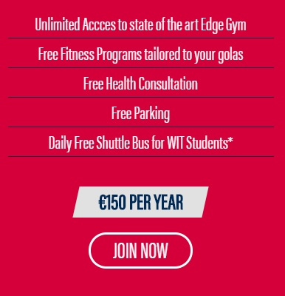
Details
Details
Details
START NOW
Notes:
I couldn’t incorporate a scrollbar, but it can be presumed the Student Membership details could be viewed successfully with scrolling.

Slide 34
MEMBERSHIP WITH US
Become a member of the WIT Arena in a few simple steps! If you have any problems during this process, feel free to check our FAQ page or contact us here. Please note you can cancel your membership plan at any stage.
Please confirm which membership plan you would like:
MONTHLY
€39 per month
PRIVATE
€299 per year
STUDENT*
€150 per year
*You will be asked to provide your student number and course / institute details for this type of membership
SEE MEMBERSHIP DETAILS
CANCEL

Slide 35
MEMBERSHIP WITH US
Become a member of the WIT Arena in a few simple steps! If you have any problems during this process, feel free to check our FAQ page or contact us here. Please note you can cancel your membership plan at any stage.
Please enter the following details regarding your current study:
Name of University / Institute*
Course Title*
Year of Entry*
Expected Year of Graduation*
YYYY
YYYY
Student Number*
Student Email Address (if applicable)
PROCEED
CANCEL

Slide 36
MEMBERSHIP WITH US
Become a member of the WIT Arena in a few simple steps! If you have any problems during this process, feel free to check our FAQ page or contact us here. Please note you can cancel your membership plan at any stage.
Please enter the following details:
Full name*
Address*
County*
Phone number*
Email Address
Date of Birth*
DD/MM/YYYY
PROCEED TO PAYMENT
CANCEL

Slide 37
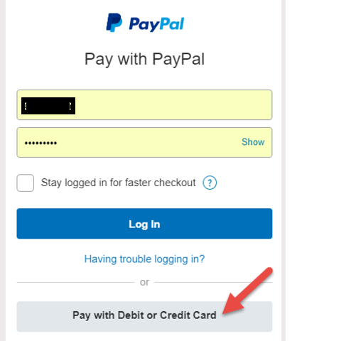
MEMBERSHIP WITH US
Become a member of the WIT Arena in a few simple steps! If you have any problems during this process, feel free to check our FAQ page or contact us here. Please note you can cancel your membership plan at any stage.
Pay with
Or enter your Debit/Credit Card details below:
Card Number*
Expiry Date*
Security Code*
MM/YYYY
CONFIRM
CANCEL

Slide 39
MEMBERSHIP SUCCESSFUL
Congratulations - Your membership has been successfully processed!
RETURN HOME

Slide 40
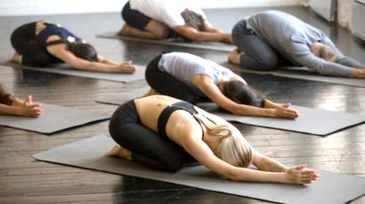
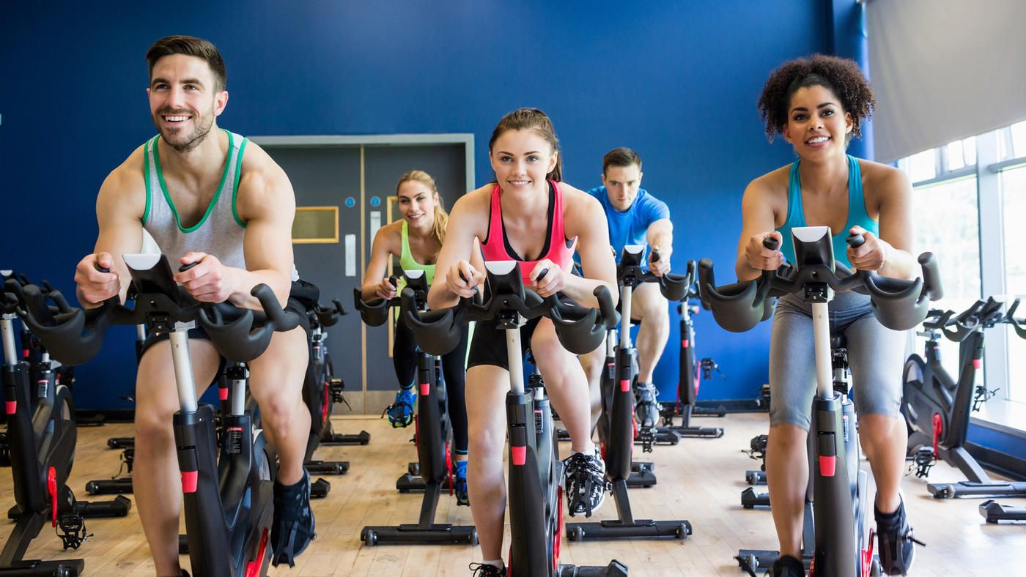
We offer a range of fitness classes for our members and non-members.
Click a class of your choice below to learn more!
PILATES
YOGA
SPIN
Notes:
More classes could be scrolled through in final app.

Slide 41
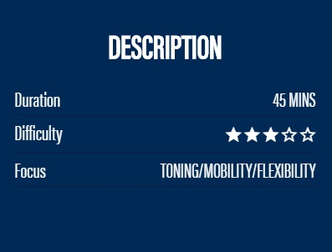
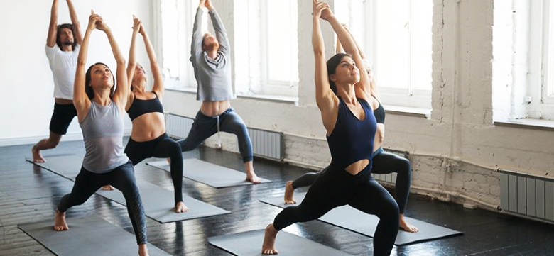
PILATES
Pilates is a body conditioning routine that helps build flexibility, lean muscles, strength and endurance in the legs, abdominals, arms, hips, and back. This form of exercise will benefit anyone, including all athletes and casual exercisers. Join one of our pilates' classes today to enjoy the benefits of improved posture and a flatter, more toned abdomen along with an upper and lower body to match.
BOOK NOW
MORE CLASSES
CUSTOMER REVIEWS
Notes:
Press enter to mimic scrolling here and view reviews.

Slide 42
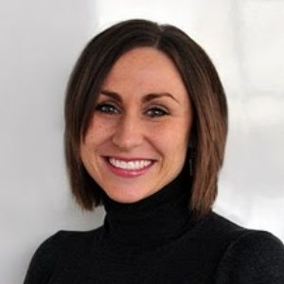


BOOK NOW
MORE CLASSES
CUSTOMER REVIEWS
Michelle, Arena Member since 2019
I’ve been attending Pilates for 3 months now and I’m in love! My body’s never felt more toned and flexible.
6
0
John, Arena Member since 2017
Good class. Would recommend.
1
0
Leave your own review
Notes:
More reviews could be scrolled through in final app. Only the top comment here can be liked or unliked for Prototype purposes.

Slide 43
BOOK NOW
MORE CLASSES
CUSTOMER REVIEWS
Michelle, Arena Member since 2019
I’ve been attending Pilates for 3 months now and I’m in love! My body’s never felt more toned and flexible.
7
0
John, Arena Member since 2017
Good class. Would recommend.
1
0
Leave your own review
Notes:
More reviews could be scrolled through in final app.

Slide 44
BOOK NOW
MORE CLASSES
CUSTOMER REVIEWS
Michelle, Arena Member since 2019
I’ve been attending Pilates for 3 months now and I’m in love! My body’s never felt more toned and flexible.
6
1
John, Arena Member since 2017
Good class. Would recommend.
1
0
Leave your own review
Notes:
More reviews could be scrolled through in final app.

Slide 45
Username, member / non member [since ….]
Add an additional comment …
BOOK NOW
MORE CLASSES
CUSTOMER REVIEWS
POST
Michelle, Arena Member since 2019
I’ve been attending Pilates for 3 months now and I’m in love! My body’s never felt more toned and flexible.
Share to Facebook
6
0
John, Arena Member since 2017
Share to Twitter
Good class. Would recommend.
1
0
Leave your own review
Notes:
This screen is for users who are signed in with the app.

Slide 46
Post successful
RETURN HOME
BOOK NOW
MORE CLASSES
CUSTOMER REVIEWS
Michelle, Arena Member since 2019
I’ve been attending Pilates for 3 months now and I’m in love! My body’s never felt more toned and flexible.
6
0
John, Arena Member since 2017
Good class. Would recommend.
1
0
Leave your own review
Notes:
This screen is for users who are not signed in with the app.

Slide 47
Log in or register now to leave your own review!
BOOK NOW
MORE CLASSES
CUSTOMER REVIEWS
Michelle, Arena Member since 2019
I’ve been attending Pilates for 3 months now and I’m in love! My body’s never felt more toned and flexible.
6
0
John, Arena Member since 2017
Good class. Would recommend.
1
0
Leave your own review
Notes:
This screen is for users who are not signed in with the app.

Slide 48
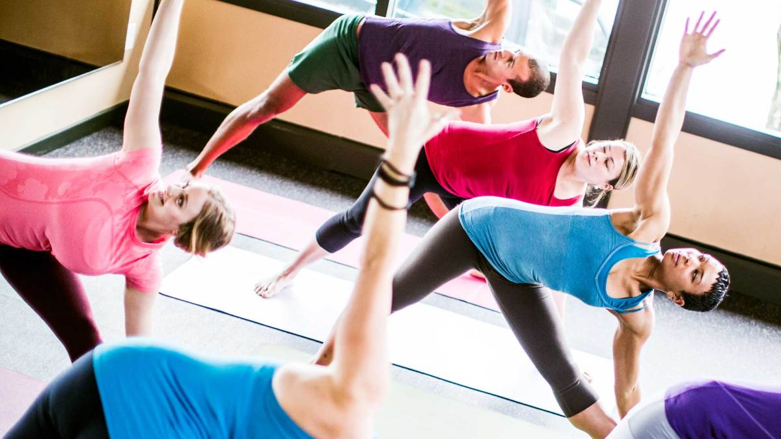
YOGA
This Yoga class is aimed at those new to yoga or those wanting a basic flow class. This class introduces foundation yoga postures, teaches you how to breath and helps you feel more comfortable in the yoga practice.
BOOK NOW
MORE CLASSES
CUSTOMER REVIEWS

Slide 49
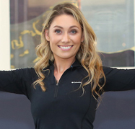
BOOK NOW
MORE CLASSES
CUSTOMER REVIEWS
Janine, Arena Member since 2014
I went to 3 classes before I had to stop – absolutely nothing wrong, lovely instructor, good basics, but this class really is for beginners! Just a warning for anyone seeking a more challenging experience like myself!
4
2
Sharon, Non-Arena Member
Really good class for people with no yoga experience like myself. Instructor is very patient and everyone is in the same boat. Made me realise a new love for yoga :)
4
0
Leave your own review
Notes:
More reviews could be scrolled through in final app.

Slide 50
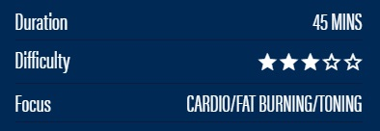

SPIN
WIT Arena Spin classes will bring you on a high intensity cycling journey, ranging from hill climbs to sprints and everything in between. Indoor cycling classes are a great way to burn fat and increase your overall fitness. This class is high intensity cardiovascular in nature but can be adapted for all fitness levels. So whether you are a beginner or advanced cyclist we can cater for your needs.
BOOK NOW
MORE CLASSES
CUSTOMER REVIEWS

Slide 51

BOOK NOW
MORE CLASSES
CUSTOMER REVIEWS
Darren, Arena Member since 2015
Great class. Can be adapted for all fitness types. Nice adrenaline rush in the morning to get me psyched for the day.
3
0
Sarah, Arena Member since 2020
This class has helped me so much on my weight loss journey. So much more productive than going to the gym and having no idea how to use the machines. Been going a month and already thrilled with the results!
3
0
Leave your own review
Notes:
More reviews could be scrolled through in final app.

Slide 52

BOOKING A CLASS WITH US
If you haven’t already, you should create an account with us to conveniently manage and book fitness classes!
Please note classes cannot be booked more than a week in advance due to availability concerns. Apologies.
Please note classes are free for members, and there is a €10 charge per class for non-members which can be paid via card here or via cash per lesson.
PILATES CLASS AVAILABILITY
Please select an available slot below:
MONDAY 20th APRIL 2020
8am-8.45am
Studio 1
MONDAY 20th APRIL 2020
4pm-4.45pm
Studio 2
WEDNESDAY 22nd APRIL 2020
6.15pm-7pm
Studio 1
FRIDAY 24th APRIL 2020
9am-9.45am
Studio 2
FRIDAY 24th APRIL 2020
7pm-7.45pm
Studio 1
No spaces currently available
CHOOSE ANOTHER CLASS
RETURN HOME

Slide 53
BOOKING A CLASS WITH US
If you haven’t already, you should create an account with us to conveniently manage and book fitness classes!
Please note classes cannot be booked more than a week in advance due to availability concerns. Apologies.
Please note classes are free for members, and there is a €10 charge per class for non-members which can be paid via card here or via cash per lesson.
YOGA CLASS AVAILABILITY
Please select an available slot below:
TUESDAY 21st APRIL 2020
4pm-4.45pm
Studio 1
WEDNESDAY 22nd APRIL 2020
6.15am-7am
Studio 2
WEDNESDAY 22nd APRIL 2020
7.15-8pm
Studio 2
No spaces currently available
THURSDAY 23rd APRIL 2020
7am-7.45am
Studio 1
CHOOSE ANOTHER CLASS
RETURN HOME

Slide 54
BOOKING A CLASS WITH US
If you haven’t already, you should create an account with us to conveniently manage and book fitness classes!
Please note classes cannot be booked more than a week in advance due to availability concerns. Apologies.
Please note classes are free for members, and there is a €10 charge per class for non-members which can be paid via card here or via cash per lesson.
SPIN CLASS AVAILABILITY
Please select an available slot below:
MONDAY 20th APRIL 2020
5pm-5.45am
Studio 1
TUESDAY 21st APRIL 2020
6.15am-7am
Studio 1
TUESDAY 21st 2020
6pm-6.45pm
Studio 2
No spaces currently available
FRIDAY 24th APRIL 2020
8.15am-9am
Studio 2
FRIDAY 24th APRIL 2020
4pm-4.45pm
Studio 2
No spaces currently available
CHOOSE ANOTHER CLASS
RETURN HOME

Slide 55
BOOKING A CLASS WITH US
If you haven’t already, you should create an account with us to conveniently manage and book fitness classes!
Please note classes cannot be booked more than a week in advance due to availability concerns. Apologies.
Please note classes are free for members, and there is a €10 charge per class for non-members which can be paid via card here or via cash per lesson.
RESERVE YOUR PLACE
LOG IN TO YOUR ACCOUNT TO CLAIM YOUR SPOT NOW
Don’t have an account with us? Manually reserve your booking below:
Please select which applies:
I am a member of the Arena, but I do not have an account with this app.
I am not a member of the Arena.
CANCEL

Slide 56
LOG IN
Log in with Facebook
Log in with Twitter
OR
Email Address
Password
LOG IN

Slide 57
LOG IN SUCCESSFUL
Your class has been successfully reserved.
If you are not a member of the Arena but wish to pay class fees via card now, please fill in your details here.
RETURN HOME

Slide 58
BOOKING A CLASS WITH US
If you haven’t already, you should create an account with us to conveniently manage and book fitness classes!
Please note classes cannot be booked more than a week in advance due to availability concerns. Apologies.
Please note classes are free for members, and there is a €10 charge per class for non-members which can be paid via card here or via cash per lesson.
RESERVE YOUR PLACE
Please enter the following details regarding your membership:
We recommend creating an account with us, so you can skip this step!
Full name*
Address*
County*
Phone number*
Date of Birth*
DD/MM/YYYY
Membership plan*
Monthly/Private/Student
PROCEED
CANCEL

Slide 59
BOOKING SUCCESSFUL
Your class has been successfully reserved.
RETURN HOME

Slide 60
BOOKING A CLASS WITH US
If you haven’t already, you should create an account with us to conveniently manage and book fitness classes!
Please note classes cannot be booked more than a week in advance due to availability concerns. Apologies.
Please note classes are free for members, and there is a €10 charge per class for non-members which can be paid via card here or via cash per lesson.
DETAILS AND PAYMENT OPTIONS
Please enter the following details:
Full name*
Phone number*
Email Address*
As a non member, you will be charged €10 per lesson you attend.
How would you like to pay this fee?
By cash on arrival
By card or Paypal now*
*The amount will automatically be charged to your card every week, but only for every lesson you attend
CANCEL

Slide 61
BOOKING A CLASS WITH US
If you haven’t already, you should create an account with us to conveniently manage and book fitness classes!
Please note classes cannot be booked more than a week in advance due to availability concerns. Apologies.
Please note classes are free for members, and there is a €10 charge per class for non-members which can be paid via card here or via cash per lesson.
PAYMENT OPTIONS
Pay with
Or enter your Debit/Credit Card details below:
Card Number*
Expiry Date*
Security Code*
MM/YYYY
CONFIRM
CANCEL

Slide 63
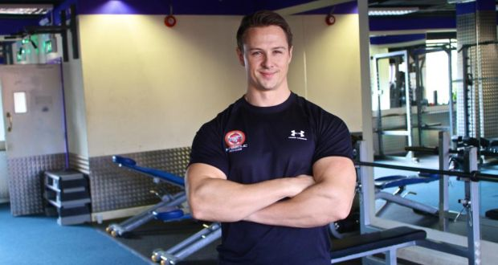
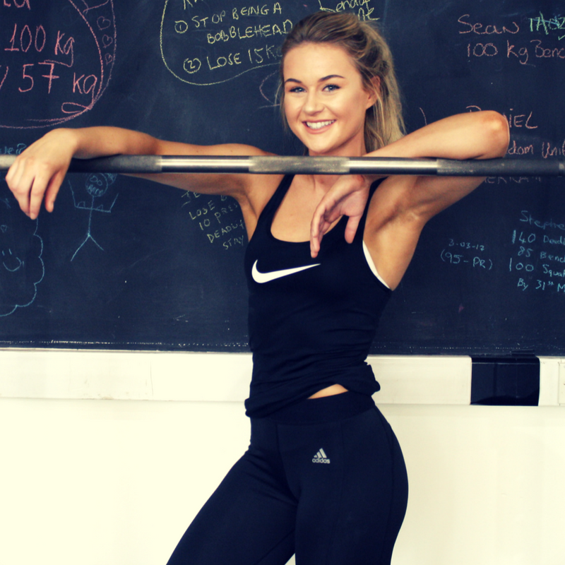

Here is your chance to get to know some of our trainers personally and even book a personal appointment with one of your choice.
Tap a friendly face below to learn more about them!
CONNOR O’BRIEN
LAUREN POWER
STEPHEN RHODE

Slide 64
CONNOR O’BRIEN – 31 years old
Connor was born and raised in Kilmacthomas, County Waterford. His education includes a PLC in Sports, Recreation, and Exercise; a level 8 degree in Sport Science with WIT; and qualified as a personal trainer with the National Training Centre Ireland. He worked as a personal trainer with Ben Dunne for 6 years before joining WIT Arena in 2017.
Connor appreciates all areas of exercise, but his biggest passion is body building and muscle strengthening. Connor is a firm believer that strengthening his body isn’t about looking the biggest, but about supporting himself and his weight in a healthy and comfortable way. He believes everyone, big or small or in between, should care about their muscle mass.
In Connor’s own words, “Don’t get me wrong – I love a bit of cardio, but muscle building is where it’s at for me! It’s not even about the looks – but they’re great too – it’s all about feeling strong and confident in your own body, knowing you can carry and support yourself in a way that’s empowering.”
BOOK AN APPOINTMENT WITH CONNOR
BACK TO INSTRUCTORS

Slide 65
LAUREN POWER – 22 years old
Lauren was born in London and moved to Waterford at the age of 4. Her education includes a Level 7 in Health and Fitness with CIT and she has been a qualified personal trainer with WIT Arena since November 2019. Although she’s young, Lauren is one of our most passionate trainers you’ll meet!
From a young age, she was always interested in sport and fitness. Her mother is a yoga instructor and her father is a member of his local men’s football team. For Lauren, exercising is all about enjoyment. She believes everyone has a form of exercise – whether it’s running on a treadmill, playing sport, or aerobics – that they can learn to love and have fun with.
In Lauren’s own words, “Fitness and exercise is a win all around. It’s good for our physical and mental health so why wouldn’t we enjoy it?! I think there’s no such thing as people who don’t enjoy some form of exercise – they just haven’t found their niche yet. There’s something for everyone, and my job is helping people find that something for them.”
BOOK AN APPOINTMENT WITH LAUREN
BACK TO INSTRUCTORS

Slide 66
STEPHEN RHODE – 40 years old
Stephen was born in County Wexford, where he lived until he met his now-wife and moved to Waterford in 2006. His education includes a Level 8 Business Degree with DCU. He’s worked in many companies, including Radius Technologies, but has trained with the National Training Centre of Ireland and WIT for the last 5 years to pursue his new goal of becoming a fitness instructor.
Stephen is open about his initial disinterest and lack of motivation with fitness and exercise. While in his early 30s, Stephen began to develop health problems due to his weight. He took this as a sign and began his own weight loss journey, which inspired his passion for fitness and wish to change his career path.
In Stephen’s own words, “To be honest, like, I was always one of them lads that never bothered with sport or exercise. I ate terrible food too and to be honest I was well overweight. My life has totally changed now for the better since I got into all this stuff. It was a challenge, but my health scare was the push I needed. I feel so much happier, more confident, and healthier since I got into fitness. I became a fitness instructor because I want to be that push for people. If I can transform just one person’s life for the better, I’ll know I’ve done my job.”
BOOK AN APPOINTMENT WITH STEPHEN
BACK TO INSTRUCTORS

Slide 67
BOOKING AN APPOINTMENT
Booking an appointment with our trainers gives you the chance to get your very own fitness program tailored to your personal fitness goals and level of fitness free of charge! Your fitness level can be determined with a fitness test, if this is something you are comfortable with.
Please note appointments are for Arena members ONLY and can only be booked a week in advance due to availability concerns. Apologies.
If you haven’t already, you should create an account with us to conveniently manage and book your appointments!
APPOINTMENT AVAILABILITY
Please select an available slot below:
MONDAY 20th APRIL 2020
9am-9.30am
12pm-12.30pm
3pm-3.30pm
6pm-6.30pm
TUESDAY 21st APRIL 2020
9am-9.30am
6pm-6.30pm
THURSDAY 23rd APRIL 2020
12pm-12.30pm
3pm-3.30pm
FRIDAY 24th APRIL 2020
9am-9.30am
12pm-12.30pm
3pm-3.30pm
CHOOSE ANOTHER TRAINER
RETURN HOME

Slide 68
BOOKING AN APPOINTMENT
Booking an appointment with our trainers gives you the chance to get your very own fitness program tailored to your personal fitness goals and level of fitness free of charge! Your fitness level can be determined with a fitness test, if this is something you are comfortable with.
Please note appointments are for Arena members ONLY and can only be booked a week in advance due to availability concerns. Apologies.
If you haven’t already, you should create an account with us to conveniently manage and book your appointments!
RESERVE YOUR APPOINTMENT
LOG IN TO YOUR ACCOUNT TO CONFIRM YOUR APPOINTMENT NOW
Don’t have an account with us? Manually reserve your appointment here
We recommend creating an account with us, so you can skip this step!
CANCEL

Slide 69
LOG IN
Log in with Facebook
Log in with Twitter
OR
Email Address
Password
LOG IN

Slide 70
LOG IN SUCCESSFUL
Your appointment has been confirmed.
RETURN HOME

Slide 71
BOOKING AN APPOINTMENT
Booking an appointment with our trainers gives you the chance to get your very own fitness program tailored to your personal fitness goals and level of fitness free of charge! Your fitness level can be determined with a fitness test, if this is something you are comfortable with.
Please note appointments are for Arena members ONLY and can only be booked a week in advance due to availability concerns. Apologies.
If you haven’t already, you should create an account with us to conveniently manage and book your appointments!
RESERVE YOUR APPOINTMENT
Please enter the following details regarding your membership:
Full name*
Address*
County*
Phone number*
Date of Birth*
DD/MM/YYYY
Membership plan*
Monthly/Private/Student
PROCEED
CANCEL

Slide 72
BOOKING SUCCESSFUL
Your appointment has been confirmed.
RETURN HOME

Slide 73
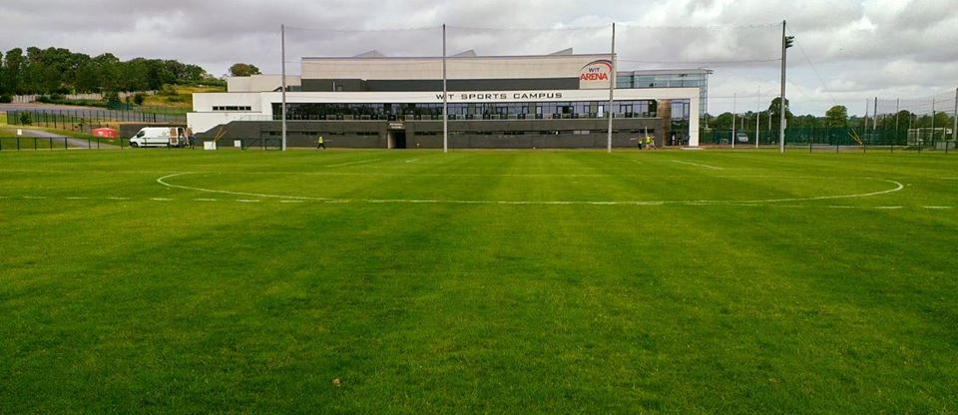
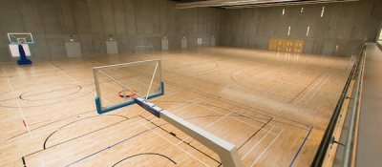
We offer everyone the chance to hire out our indoor and outdoor facilities and space for all kinds of events. Find out more here!
OUTDOOR SPACE
INDOOR SPACE

Slide 74
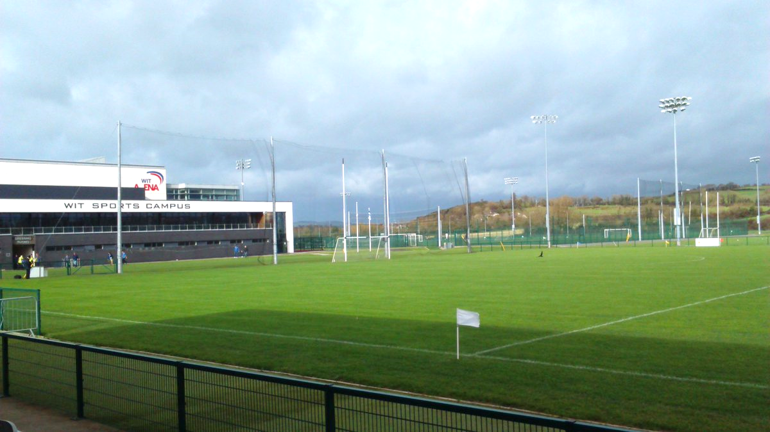
Our outdoor pitches are available for hire. Learn more about our 7 pitches here and book your spot in a few simple steps!
Grass Pitches
WIT Arena has 5 sand-based grass pitches available for hire. These consist of:
Four GAA pitches, three of which are fully floodlit
One full sized soccer pitch
These pitches are complimented with fully floodlit training areas for warm up and running
based drills.
All Weather
WIT Arena also has a fully floodlit All Weather Area (3G Surface)
One Full sized GAA pitch
Two full sized soccer pitches
Four 7 a-side soccer pitches
HIRE OUT A PITCH NOW

Slide 75
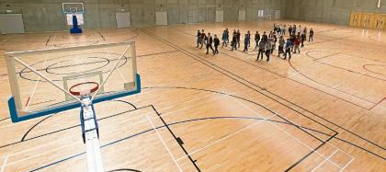
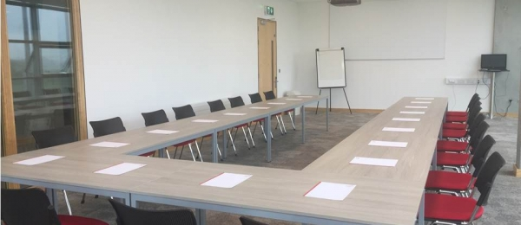
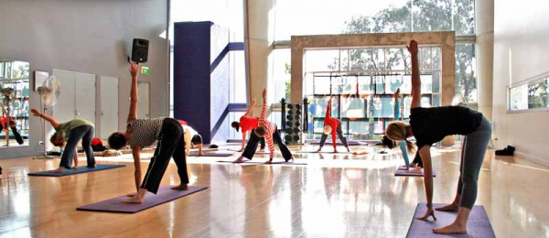
We offer everyone the chance to hire out our indoor and outdoor facilities and space for all kinds of events. Find out more here!
AUDITORIUM
SPORTS HALL
ROOMS / STUDIOS

Slide 76
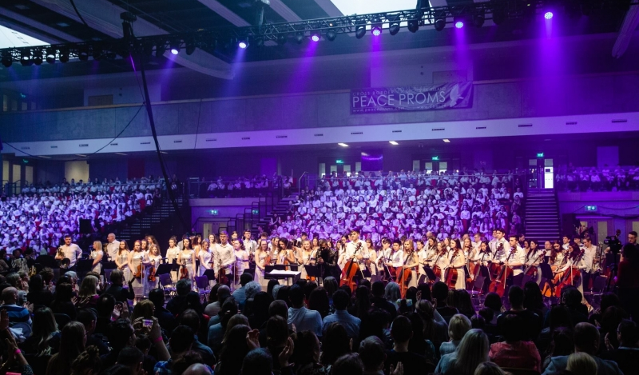
Our Auditorium is a popular venue for all types of major events: conferences, open days, concerts, awards ceremonies, exhibits and more!
Our large open space with 10 ascending rows of seats can be adapted for all occasions, with our state of the art technologies that help us host even the largest of events.
HIRE OUT THE AUDITORIUM NOW

Slide 77
Our Sports Hall is 2000sqm.
The hall has 3 courts and can cater for:
Basketball (2 full size courts and 2 half courts for training).
Badminton
5 aside soccer
Futsal
Volleyball
Badminton
Olympic Handball
Table Tennis
HIRE OUT OUR SPORTS HALL NOW

Slide 78
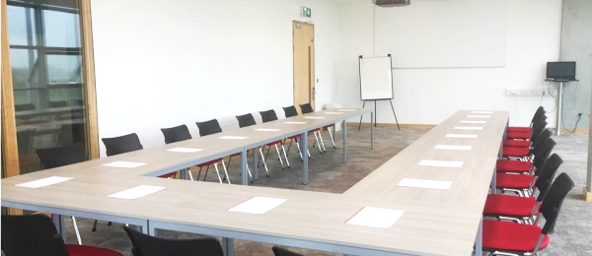
Training Rooms
We provide a number of training rooms that may act as multi-purpose facilities for various functions and occasions. The spaces available at the Arena are ideal for boardroom meetings, training days and smaller, more intimate conferences. Our studio room can cater for up to 200 people or can be divided into two separate rooms catering for 80 individuals each. In addition to this, there are a further three teaching/meeting rooms which are suitable for 40-60 individuals. Data projector and screen along with white boards and flip chart facilities are available with all room hire.
Studios
Glance inside our fitness studio and you will quickly see why it is one of the most favourable spots to exercise in within the whole facility. One wall is made entirely of glass, flooding the room with natural light and giving panoramic views across the surrounding all-weather and grass pitches. The opposite wall is covered with full length mirrors increasing the spacious feel of this studio. Bright and well ventilated with a solid hardwood floor, it is the perfect location for a group exercise class and an environment that certainly adds motivation to your workout and fitness class experience.
HIRE OUT A ROOM NOW

Slide 79
HIRING A PITCH
Placing a request to hire a pitch is quick and easy with us. Once your request has been processed, we will be in contact with you shortly regarding deposit and payment details (if applicable).
We rent out our pitches in hour slots and allow reservations up to 6 months in advance.
If you haven’t already, you should create an account with us to conveniently manage your bookings and pay fees online!
PITCH AVAILABILITY
Please select a date below to see availability:
APRIL 2020
MAY 2020
JUNE 2020
JULY 2020
AUGUST 2020
SEPTEMBER 2020
NEXT
CANCEL
Notes:
For Prototype demonstration purposes, only ‘April’ is available to hire here.

Slide 80
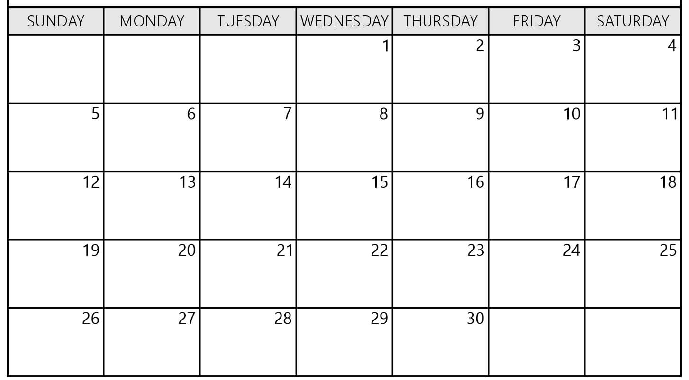
HIRING A PITCH
Placing a request to hire a pitch is quick and easy with us. Once your request has been processed, we will be in contact with you shortly regarding deposit and payment details (if applicable).
We rent out our pitches in hour slots and allow reservations up to 6 months in advance.
If you haven’t already, you should create an account with us to conveniently manage your bookings and pay fees online!
PITCH AVAILABILITY
Please select a date below to see availability:
APRIL 2020
MAY 2020
JUNE 2020
JULY 2020
AUGUST 2020
SEPTEMBER 2020
SLOTS AVAILABLE
SLOTS AVAILABLE
SLOTS AVAILABLE
SLOTS AVAILABLE
SLOTS AVAILABLE
SLOTS AVAILABLE
SLOTS AVAILABLE
CANCEL
Notes:
For Prototype demonstration purposes, only ‘April’ is available to hire here.

Slide 81
HIRING A PITCH
Placing a request to hire a pitch is quick and easy with us. Once your request has been processed, we will be in contact with you shortly regarding deposit and payment details (if applicable).
We rent out our pitches in hour slots and allow reservations up to 6 months in advance.
If you haven’t already, you should create an account with us to conveniently manage your bookings and pay fees online!
PITCH AVAILABILITY
Please select (a) slot(s) below:
10am – 11am
11am – 12pm
3pm – 4pm
6pm – 7pm
CANCEL
Notes:
In the final version, users would be able to choose multiple slots.

Slide 82
HIRING A PITCH
Placing a request to hire a pitch is quick and easy with us. Once your request has been processed, we will be in contact with you shortly regarding deposit and payment details (if applicable).
We rent out our pitches in hour slots and allow reservations up to 6 months in advance.
If you haven’t already, you should create an account with us to conveniently manage your bookings and pay fees online!
DETAILS
Please select which applies:
This is a once-off hire.
OR
I would like to reserve this hire
on a weekly basis
on a bi-weekly basis
on a monthly basis
other (please specify):
NEXT
CANCEL
Notes:
In the final version, users would be able to choose multiple slots.

Slide 83
HIRING A PITCH
Placing a request to hire a pitch is quick and easy with us. Once your request has been processed, we will be in contact with you shortly regarding deposit and payment details (if applicable).
We rent out our pitches in hour slots and allow reservations up to 6 months in advance.
If you haven’t already, you should create an account with us to conveniently manage your bookings and pay fees online!
DETAILS
Please fill in the following details regarding your hire:
Your name*
Name of club / organisation / team (if applicable)
Purpose of hire (brief description)*
Contact phone number*
Contact Email Address
I understand and accept that hire charge cannot be estimated at this time and WIT Arena will be in contact with me soon regarding my hire.
SUBMIT
CANCEL
Notes:
In the final version, users would be able to choose multiple slots.

Slide 84
REQUEST FOR HIRE SUCCESSFUL
Your slot has been reserved and a member of our staff will contact you shortly for further details.
RETURN HOME

Slide 85
HIRING OUR AUDITORIUM
Placing a request to hire out our auditorium is quick and easy with us. Once your request has been processed, we will be in contact with you shortly regarding deposit and event details.
We rent out our auditorium in day slots and allow reservations up to 6 months in advance.
If you haven’t already, you should create an account with us to conveniently manage your bookings and pay fees online!
AVAILABILITY
Please select a date below to see availability:
APRIL 2020
MAY 2020
JUNE 2020
JULY 2020
AUGUST 2020
SEPTEMBER 2020
CANCEL
Notes:
For Prototype demonstration purposes, only ‘April’ is available to hire here.

Slide 86
HIRING OUR AUDITORIUM
Placing a request to hire out our auditorium is quick and easy with us. Once your request has been processed, we will be in contact with you shortly regarding deposit and event details.
We rent out our auditorium in day slots and allow reservations up to 6 months in advance.
If you haven’t already, you should create an account with us to conveniently manage your bookings and pay fees online!
AVAILABILITY
Please select a date below to see availability:
APRIL 2020
MAY 2020
JUNE 2020
JULY 2020
AUGUST 2020
SEPTEMBER 2020
SLOT AVAILABLE
SLOT AVAILABLE
SLOT AVAILABLE
SLOT AVAILABLE
CANCEL
Notes:
For Prototype demonstration purposes, only ‘April’ is available to hire here.

Slide 87
HIRING OUR AUDITORIUM
Placing a request to hire out our auditorium is quick and easy with us. Once your request has been processed, we will be in contact with you shortly regarding deposit and event details.
We rent out our auditorium in day slots and allow reservations up to 6 months in advance.
If you haven’t already, you should create an account with us to conveniently manage your bookings and pay fees online!
DETAILS
Please fill in the following details regarding your hire:
Your name*
Name of club / organisation / team (if applicable)
Purpose of hire (brief description)*
Contact phone number*
Contact Email Address
I understand and accept that hire charge cannot be estimated at this time and WIT Arena will be in contact with me soon regarding my hire.
SUBMIT
CANCEL
Notes:
In the final version, users would be able to choose multiple slots.

Slide 88
HIRING INDOOR SPACE
Placing a request to hire indoor space is quick and easy with us. Once your request has been processed, we will be in contact with you shortly regarding deposit and payment details (if applicable).
We rent out our indoor space in hour slots and allow reservations up to 6 months in advance.
If you haven’t already, you should create an account with us to conveniently manage your bookings and pay fees online!
AVAILABILITY
Please select a date below to see availability:
APRIL 2020
MAY 2020
JUNE 2020
JULY 2020
AUGUST 2020
SEPTEMBER 2020
CANCEL
Notes:
For Prototype demonstration purposes, only ‘April’ is available to hire here.

Slide 89
HIRING INDOOR SPACE
Placing a request to hire indoor space is quick and easy with us. Once your request has been processed, we will be in contact with you shortly regarding deposit and payment details (if applicable).
We rent out our indoor space in hour slots and allow reservations up to 6 months in advance.
If you haven’t already, you should create an account with us to conveniently manage your bookings and pay fees online!
AVAILABILITY
Please select a date below to see availability:
APRIL 2020
MAY 2020
JUNE 2020
JULY 2020
AUGUST 2020
SEPTEMBER 2020
SLOTS AVAILABLE
SLOTS AVAILABLE
SLOTS AVAILABLE
SLOTS AVAILABLE
SLOTS AVAILABLE
SLOTS AVAILABLE
SLOTS AVAILABLE
CANCEL
Notes:
For Prototype demonstration purposes, only ‘April’ is available to hire here.

Slide 90
HIRING INDOOR SPACE
Placing a request to hire indoor space is quick and easy with us. Once your request has been processed, we will be in contact with you shortly regarding deposit and payment details (if applicable).
We rent out our indoor space in hour slots and allow reservations up to 6 months in advance.
If you haven’t already, you should create an account with us to conveniently manage your bookings and pay fees online!
AVAILABILITY
Please select (a) slot(s) below:
10am – 11am
11am – 12pm
3pm – 4pm
6pm – 7pm
CANCEL
Notes:
In the final version, users would be able to choose multiple slots.

Slide 91
HIRING INDOOR SPACE
Placing a request to hire indoor space is quick and easy with us. Once your request has been processed, we will be in contact with you shortly regarding deposit and payment details (if applicable).
We rent out our indoor space in hour slots and allow reservations up to 6 months in advance.
If you haven’t already, you should create an account with us to conveniently manage your bookings and pay fees online!
DETAILS
Please select which applies:
This is a once-off hire.
OR
I would like to reserve this hire
on a weekly basis
on a bi-weekly basis
on a monthly basis
other (please specify):
NEXT
CANCEL
Notes:
In the final version, users would be able to choose multiple slots.

Slide 92
HIRING INDOOR SPACE
Placing a request to hire indoor space is quick and easy with us. Once your request has been processed, we will be in contact with you shortly regarding deposit and payment details (if applicable).
We rent out our indoor space in hour slots and allow reservations up to 6 months in advance.
If you haven’t already, you should create an account with us to conveniently manage your bookings and pay fees online!
DETAILS
Please fill in the following details regarding your hire:
Your name*
Name of club / organisation / team (if applicable)
Purpose of hire (brief description)*
Contact phone number*
Contact Email Address
I understand and accept that hire charge cannot be estimated at this time and WIT Arena will be in contact with me soon regarding my hire.
SUBMIT
CANCEL
Notes:
In the final version, users would be able to choose multiple slots.

Slide 93
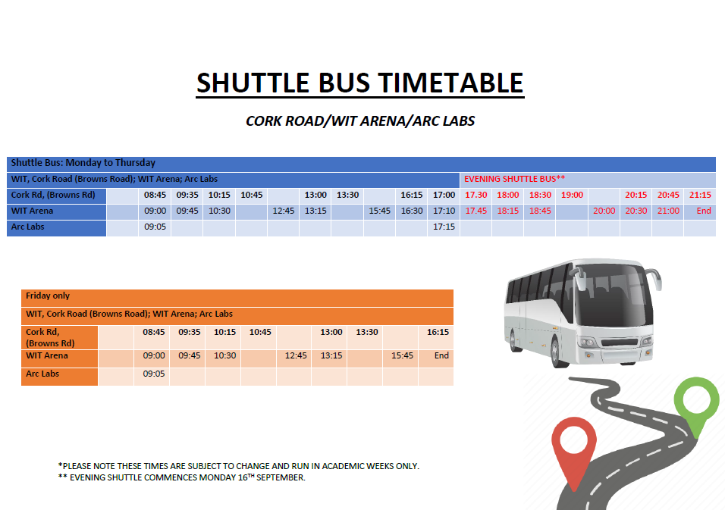
RETURN HOME

Slide 94
MAP OF THE ARENA
Tap on an area to see more
OUTDOORS
2km outdoor running track
Grass pitch
Grass pitch
Grass pitch
Grass pitch
Grass pitch
Astro-turf pitch
WIT Arena
Astro-turf pitch
Car Park
RETURN HOME
Notes:
I know this sketch is completely inaccurate and not very well done at all, but the idea is there!

Slide 95

MAP OF THE ARENA
Tap on an area to see more
BOTTOM FLOOR
To upper floor
Locker Room
Women’s changing room
Men’s changing room
Toilets
Water fountain
Indoor Sports Hall
Café / Seating Area
To upper floor
Auditorium
Front entrance
RETURN HOME
Notes:
I know this sketch is completely inaccurate and not very well done at all, but the idea is there!

Slide 96
MAP OF THE ARENA
Tap on an area to see more
FIRST FLOOR
To lower floor
Meeting Room 1
Studio 1
50m sprint track
Auditorium
Upper Level
To lower floor
Studio 2
To upper floor
High Performance Gym
RETURN HOME
Notes:
I know this sketch is completely inaccurate and not very well done at all, but the idea is there!

Slide 97
MAP OF THE ARENA
Tap on an area to see more
TOP FLOOR
Meeting Room 2
To lower floor
Standard ‘Edge’ Gym
RETURN HOME
Notes:
I know this sketch is completely inaccurate and not very well done at all, but the idea is there!

Slide 98

OUR CAFÉ MENU
Opening Times:
Monday – Friday 8.00am – 10.00pm
Saturday & Sunday 9.00am – 8.00pm
RETURN HOME
Notes:
Go to the next slide to mimic scrolling

Slide 99

OUR CAFÉ MENU
Opening Times:
Monday – Friday 8.00am – 10.00pm
Saturday & Sunday 9.00am – 8.00pm
RETURN HOME
Notes:
Go to the next slide to mimic scrolling

Slide 100

OUR CAFÉ MENU
Opening Times:
Monday – Friday 8.00am – 10.00pm
Saturday & Sunday 9.00am – 8.00pm
RETURN HOME
Notes:
Go to the next slide to mimic scrolling

